Slide 1
COVID-19 Statistics
02-05-2020

Slide 2
Latest Statistics
(updated 02-05-2020)
Total confirmed cases worldwide: 3,426,622
83,566 new cases (2% increase)
Total fatal cases worldwide: 243,793
5,189 new fatalities (2% increase)
Israel recorded 16,185 cases in total
increased by 84 cases (0% increase)
27.0# in confirmed cases, 41.0# in mortality
23.0# in cases per capita, 38.0# in mortality rate

Slide 3
Latest Statistics
(updated 02-05-2020)
Worldwide mortality rate: 7.1% (-0.0%)
Israel mortality rate: 1.4% (+0.0%)
US has most cases in total (1,132,539)
US has most fatal cases in total (US)
US recorded the most new cases (29,078)
US recorded the most new fatal cases (1,426)

Slide 4
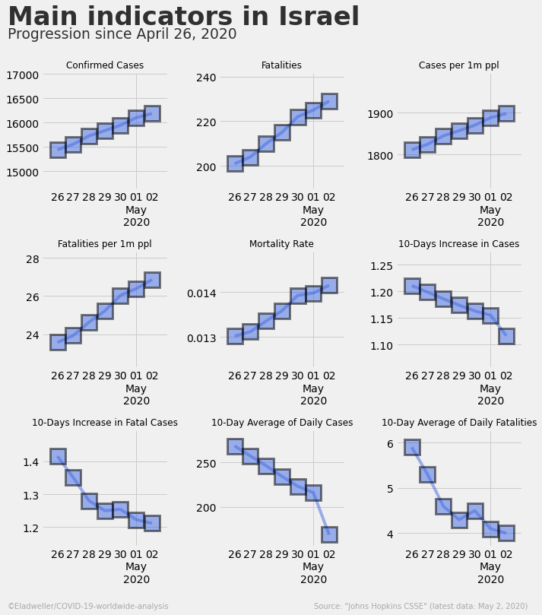

Slide 5
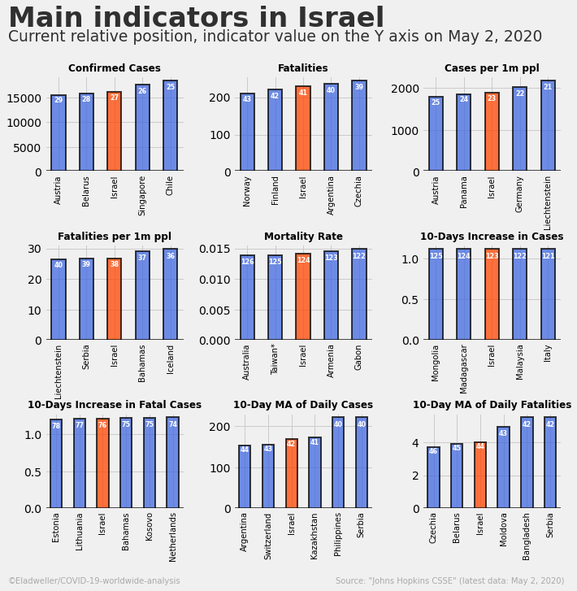

Slide 6
